Slide 1
Introduction
Feature Dataset
Model Accuracy comparison after testing
Project progress
EMPLOYEE ATTRITION PREDICTION AND ANALYSIS
Jeevan Jose
MCA semester VI
Department of Computer Applications Government Engineering college Thrissur
Guided by, Aswathy M C

Slide 2
Introduction
Feature Dataset
Model Accuracy comparison after testing
Project progress
Introduction
Employee Attrition is the gradual reduction in staff members that occurs as employees retire or resign and are not replaced. Employee attrition can be costly for businesses. The company loses employee productivity, and employee knowledge.
Why do we predict attrition? Predictive Attrition Model helps in not only taking preventive measures but also into making better hiring decisions. Deriving trends in the candidate’s performance out of past data is important in order to predict the future trends, as well as to board new employees.
It helps in Managing workforce, Smooth pipeline, Hiring Management

Slide 3
Introduction
Feature Dataset
Model Accuracy comparison after testing
Project progress
Feature set
Job satisfaction Environment satisfaction Work life balance
Job Involvement Current position Years at company
Number of companies worked Years since last promotion Years under same manager
Performance rating Relationship satisfaction Total working hours Training times last year

Slide 4
Introduction Feature Dataset
Random Forest Model
Model Accuracy comparison after testing
Project progress
Random forest is a Supervised Machine Learning Algorithm that is used widely in Classification and Regression problems.
It builds decision trees on different samples and takes their majority vote for classification and average in case of regression.

Slide 5
Introduction Feature Dataset
Decision Tree Model
Model Accuracy comparison after testing
Project progress
What makes decision trees special in the realm of ML models is really their clarity of information representation.
The “knowledge” learned by a decision tree through training is directly formulated into a hierarchical structure.
This structure holds and displays the knowledge in such a way that it can easily be understood, even by non-experts.

Slide 6
Introduction
Feature Dataset
Model Accuracy comparison after testing
Project progress
KNN Model
K-Nearest Neighbour is one of the simplest Machine Learning algorithms based on Supervised Learning technique.
K-NN algorithm assumes the similarity between the new case/data and available cases and put the new case into the category that is most similar to the available categories.
K-NN algorithm stores all the available data and classifies a new data point based on the similarity. This means when new data appears then it can be easily classified into a well suite category by using K- NN algorithm.

Slide 7
Introduction Feature Dataset
Logistic Regression
Model Accuracy comparison after testing
Project progress
Logistic regression is a statistical analysis method to predict a binary outcome, such as yes or no, based on prior observations of a data set.
Like all regression analyses, the logistic regression is a predictive analysis.
Logistic regression is used to describe data and to explain the relationship between one dependent binary variable and one or more nominal, ordinal, interval or ratio-level independent variables.

Slide 8
Introduction Feature Dataset
Naive Bayes Model
Model Accuracy comparison after testing
Project progress
Naive Bayes classifiers are a collection of classification algorithms based on Bayes’ Theorem.
It is not a single algorithm but a family of algorithms where all of them share a common principle, i.e. every pair of features being classified is independent of each other.
each feature is given the same weight(or importance). For example, knowing only temperature and humidity alone can’t predict the outcome accurately.

Slide 9
Introduction
Feature Dataset
Model Accuracy comparison after testing
Project progress
SVM model
The objective of the support vector machine algorithm is to find a hyperplane in an N-dimensional space(N — the number of features) that distinctly classifies the data points.
To separate the two classes of data points, there are many possible hyperplanes that could be chosen. Our objective is to find a plane that has the maximum margin
Maximizing the margin distance provides some reinforcement so that future data points can be classified with more confidence.

Slide 10
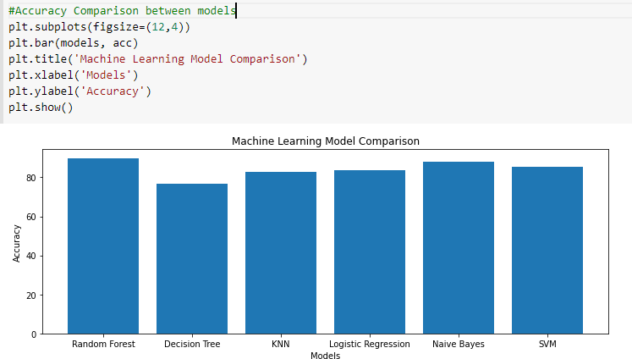
Introduction Feature Dataset
Accuracy statistics
Model Accuracy comparison after testing
Project progress
Figure 1:

Slide 11
Introduction
Feature Dataset
Model Accuracy comparison after testing
Project progress
Integration
Flask is a web framework, it’s a Python module that lets you develop web applications easily.
Html files are integrated to python using flask.
User data is fetch and forwarded to python files using JSON.
In Flask web applications, to manipulate databases, we can use SQL and Object Relational Mapping (ORM)

Slide 12
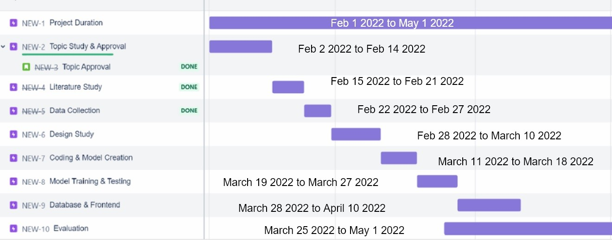
Introduction Feature Dataset
Project progress
Model Accuracy comparison after testing
Project progress
Figure 2:

Slide 13
Introduction
Feature Dataset
Model Accuracy comparison after testing
Project progress
THANK YOU

